Slide 1

Sleep apnea detection

Slide 2
What is sleep apnea and idea behind the project?
Sleep apnea is a common disorder that causes your breathing to stop or get very shallow. Breathing pauses can last from a few seconds to minutes. They may occur 30 times or more an hour.
Sleep apnea is a serious breathing disorder with more than one million cases being reported in a year in India.

Slide 3
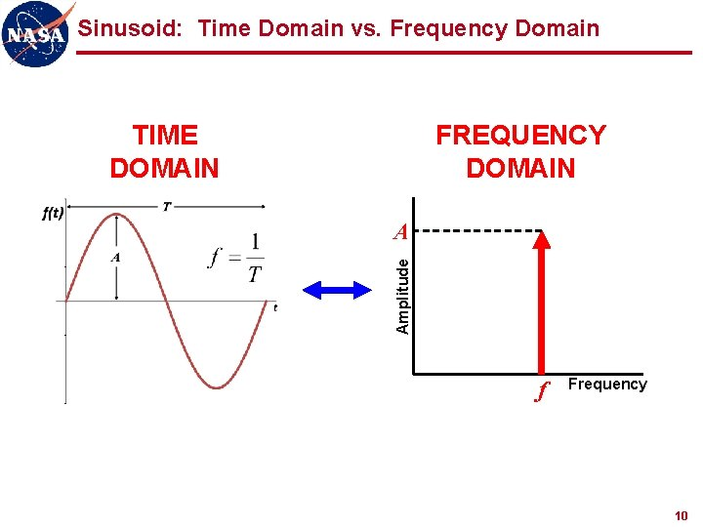
IMPLEMENTATION/APPROACH
We have a dataset of 10 audio files of approximately same time duration in which 5 are of apneatic patients and 5 are of non-apneatic patients. to perform operations on the input, MATLAB is used as the software.
Using MATLAB the two important task that are done are-
Plotting the audio signal in the time domain.
Plotting the signal in the frequency domain.
This is done for the entire dataset and then by comparison
we are able to obtain certain threshold values and if for a
Person the value is more than the threshold value, chances
of apnea increases

Slide 4
Implementation/approach
One of the most common symptom of sleep apnea is snoring and irregular breathing, by observing the time domain we can see the nature of breaths which in a normal person has to be regular where the peaks also have values equal to each other.
Whereas for an apneatic person, the pattern should come out to be irregular with the peaks having very large values as compared to normal/standard values.
Snoring is considered to be normal only below the frequency of 500 Hz, using frequency domain, we will be able to observe the variation in frequency for an input.

Slide 5
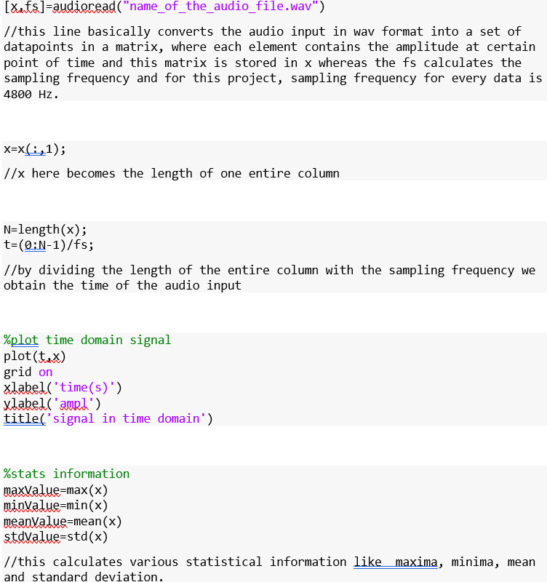
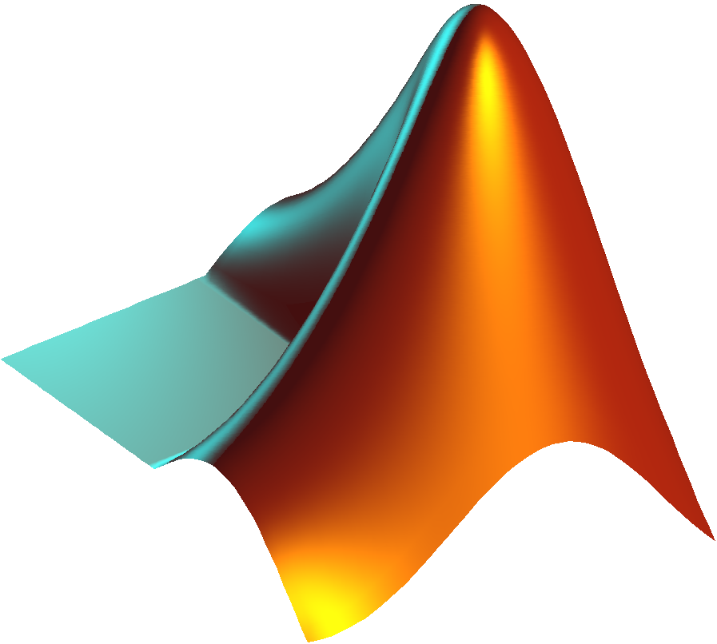
code
Time domain analysis-:

Slide 6
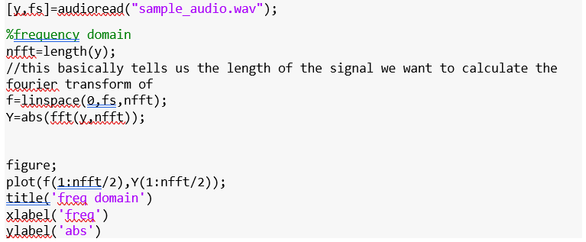
code
Frequency domain analysis-:

Slide 7
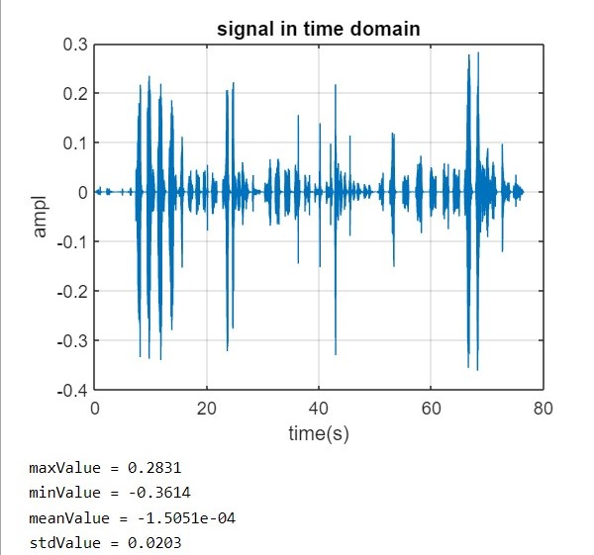
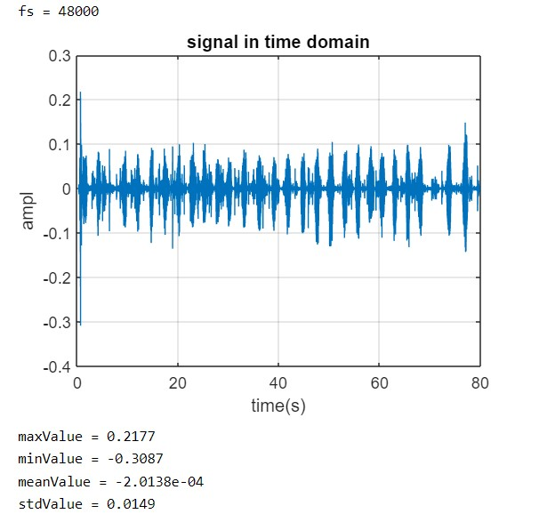
output
Time domain plot for an apneatic person
Time domain plot for a non-apneatic patient

Slide 8
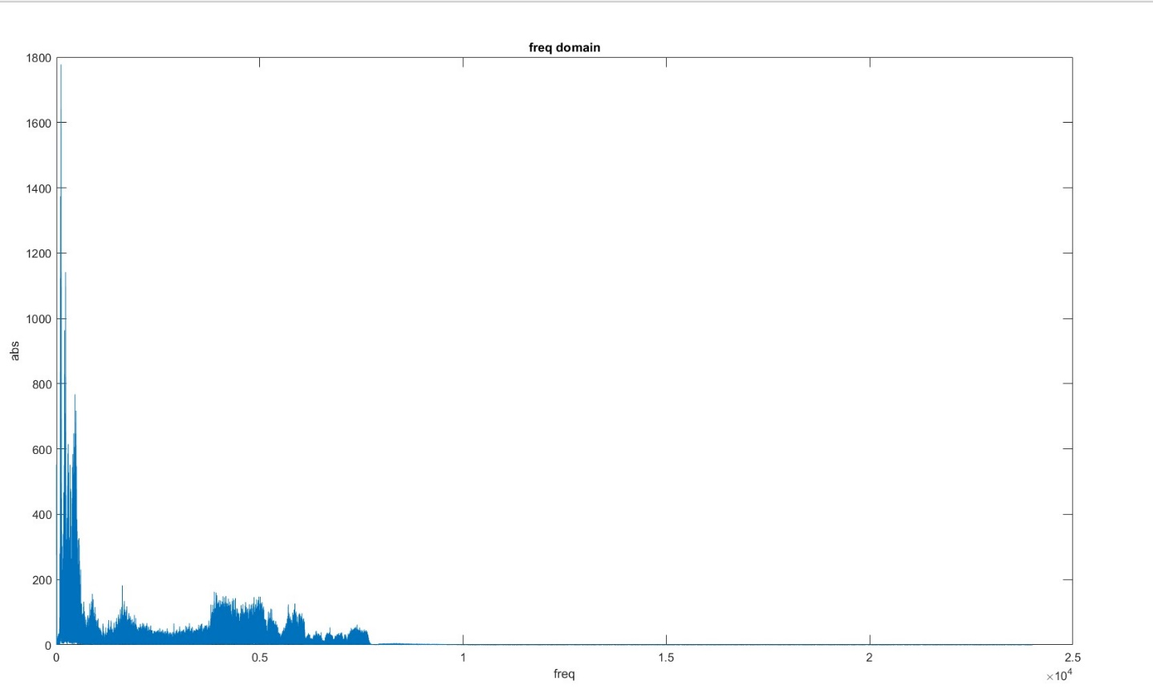
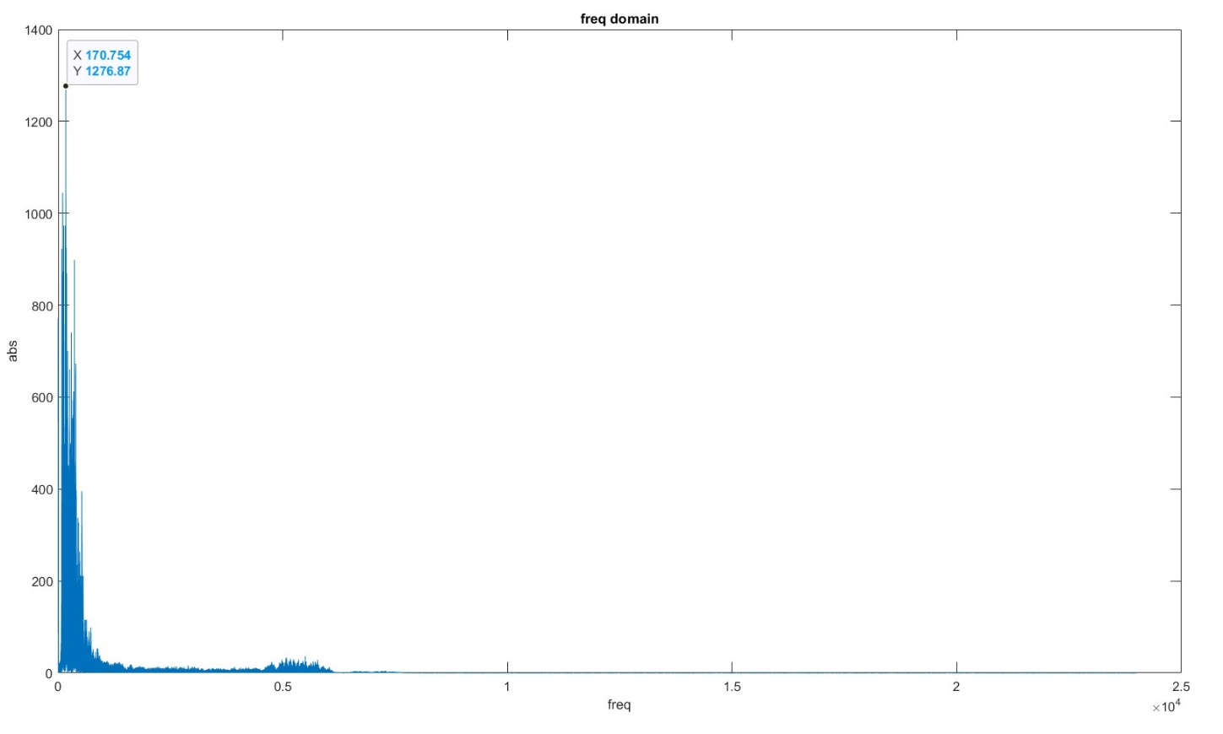
output
Frequency domain plot for an apneatic person
Frequency daomin plot for a non-apneatic person

Slide 9
conclusion
From the time domain analysis we can clearly see, the difference in the breathing pattern of an apneatic person and that of a non-apneatic person.
From the frequency domain, we can see that how in a normal person the energy is largely concentrated below the region of 500 Hz whereas in the case of an apneatic person, the energy is also shared in the region of 400 Hz to 1000 Hz. Therefore, the threshold frequency of snoring can be considered to be 500 Hz, above which if there is a distribution of energy, the chances of apnea increases for that particular person.

Slide 10
Scope/limitations
In Future we can use the current model and modify using Machine learning and Neural Network to directly Identify the Sleep Apnea.
We can make our model more perfect and accurate using more Dataset in the future
We can also modify our Model to detect other breathing related disease like Asthma , Chronic bronchitis and Cystic fibrosis.
We can also use the Given model to detect small Problems related to Heart.

Slide 11
Thank you

